Slide 1
Chapter 7
Taking the Nation’s
Economic Pulse

Slide 2
GDP
A Measure of Output

Slide 3
GDP – A Measure of Output
Gross Domestic Product (GDP):
The market value of final goods and services produced within a country during a specific time period, usually a year.
GDP is the most widely used indicator of economic performance.
Notes:
GDP is the most widely used measure of economic performance. The GDP figures are closely watched both by policy-makers and by those in the business and financial communities. In the United States, the numbers are prepared quarterly and released a few weeks following the end of each quarter.

Slide 4
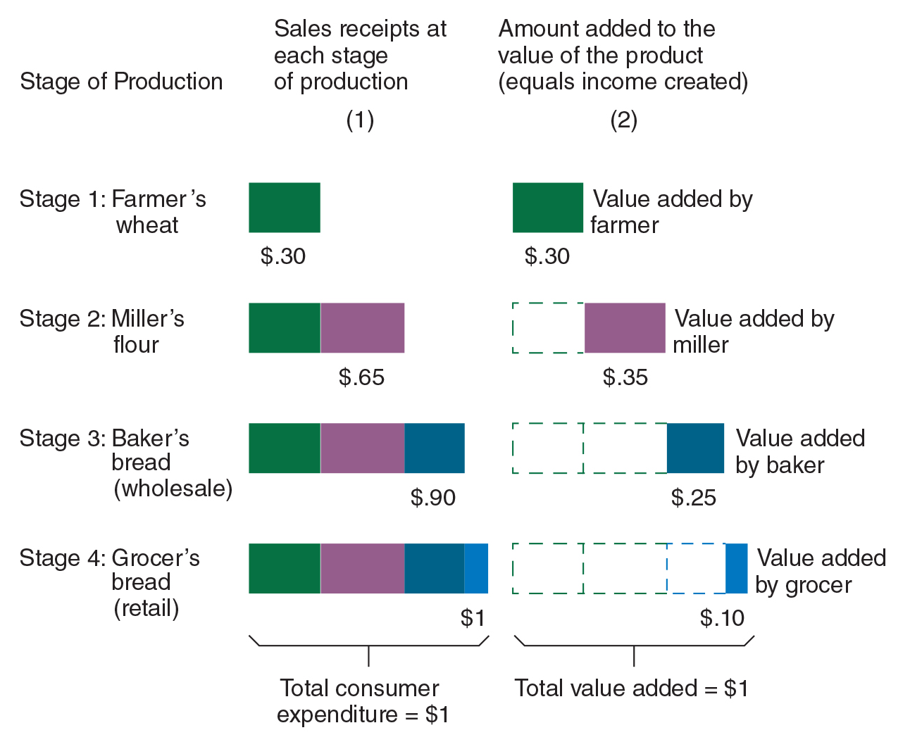
What Counts Towards GDP?
Only final goods and services count
  Sales at intermediate stages of production are not counted as their value is embodied within the final-user good.
  Including goods at intermediate stages of production would result in double counting.

Slide 5
What Counts Toward GDP?
What Counts Toward GDP?
Only transactions involving production count.
Financial transactions and income transfers are excluded because they do not reflect actual production.
Only production within the geographic borders of the country is counted.
Only those goods produced during the current period are counted.
Thus, the purchase and sale of goods produced during earlier years are not counted in this year’s GDP.

Slide 6
Dollars are the Common Denominator for GDP
GDP is measured in dollars.
Each good produced increases output by the amount the purchaser pays for the good.
The total spending on all final-user goods and services produced during the year is summed, in dollar terms, to obtain the annual GDP.

Slide 7

Outstanding Economist: Simon Kuznets
• Simon Kuznets provided the methodology for modern national-income accounting and developed the first reliable national-income measures for the United States.
• Kuznets is often referred to as the “father of national-income accounting.” A native Russian, he immigrated to the United States at the age of 21 and spent his academic career teaching at the University of Pennsylvania, Johns Hopkins University, and Harvard University.
AP Images

Slide 8
Questions for Thought:
1. Indicate how each of the following activities will affect GDP:
(a) You pay $600 per month to lease an apartment while attending school.
(b) You pay $8,000 to purchase a four-year-old car.
(c) You have car trouble and have to pay a repair shop $1,500 to fix the transmission of your car.
(d) You pay $5,100 to purchase 100 shares of Microsoft stock ($50 per share for the stock plus a $100 brokerage fee).
(e) You sell your 100 shares of Apple stock (purchased for $30,000) for $40,000 minus a $500 brokerage fee.
(f) Your aunt sends you $500 to help with college expenses.
(g) You earn $500 providing computer services for a faculty member.
(h) You win $500 playing cards with classmates in the dormitory.

Slide 9
Questions for Thought:
2. Why isn’t the purchase of an intermediate good like steel used to build automobiles and the purchase of the new automobile itself both included in GDP?

Slide 10
GDP as a Measure of
Both Output and Income

Slide 11
Two Ways of Measuring GDP
Dollar flow of expenditures on final goods
GDP
Dollar flow of income (and indirect cost) of final goods
GDP is a measure of both output and income. Thus, there are two ways it can be measured.
  GDP can be derived by totaling the expenditures on final-user goods and services produced during the year.
    This is called the expenditure approach.
  Alternatively, GDP can be calculated by summing the income payments to the resource suppliers and the indirect cost of producing the goods and services.
    This is called the resource cost-income approach.
Notes:
There are two ways of looking at and measuring GDP. First, the GDP of an economy can be reached by totaling the expenditures on goods and services produced during the year (the expenditure approach). Alternatively, GDP can be calculated by summing the income payments to the resource suppliers of the things used to produce those goods and services (the resource cost–income approach). Production of goods and services is costly because the resources required for their production must be bid away from their alternative uses. These costs generate incomes for resource suppliers.

Slide 12
Expenditure Method of Measuring GDP
Expenditure Approach:
GDP is the sum of expenditures on final-user goods and services purchased by households, investors, governments, and foreigners.
When calculated by this method, there are 4 components of GDP:
personal consumption purchases
gross private investment(including inventories)
government purchases (consumption and investment)
net exports (exports minus imports)
Notes:
When derived by the expenditure approach, GDP has four components: (1) personal consumption expenditures, (2) gross private domestic investment, (3) government consumption and gross investment, and (4) net exports to foreigners.

Slide 13
Resource Cost-Income Method of Measuring GDP
Resource Cost - Income Approach:
GDP is the sum of costs incurred and income (including profits) generated by the production of goods and services in the period.
Sum of these = national income
The direct cost income components of GDP:
employee compensation
self-employment income
rents
interest
corporate profits
Notes:
We can also calculate GDP by summing the flow of costs incurred and income generated.

Slide 14
Resource Cost-Income Method of Measuring GDP
Resource Cost - Income Approach:
Not all cost components of GDP result in an income payment to a resource supplier. To get GDP using this method, we need to account for 3 other factors:
Indirect business taxes:
Depreciation:
Taxes that increase firm’s production costs.
Cost of wear and tear on the machines and other capital assets used to produce goods and services.
Net Income of Foreigners:
The income that foreigners earn producing goods within the borders of the U.S. minus the income Americans earn abroad.

Slide 15
Resource Cost-Income Method of Measuring GDP
When GDP is derived using the Resource Cost - Income Approach, it is calculated as the sum of:
national income (employee compensation, self-employment income, rents, interest, corporate profits),
indirect business taxes,
depreciation, and,
net income of foreigners.
Notes:
Because GDP is a measure of domestic output, the net income earned by foreigners must be added when GDP is derived using the resource cost-income approach. The net income of foreigners is equal to the income foreigners earn in the United States minus the income that Americans earn abroad. If Americans earn more abroad than foreigners earn in the United States, the net income of foreigners will be negative.

Slide 16
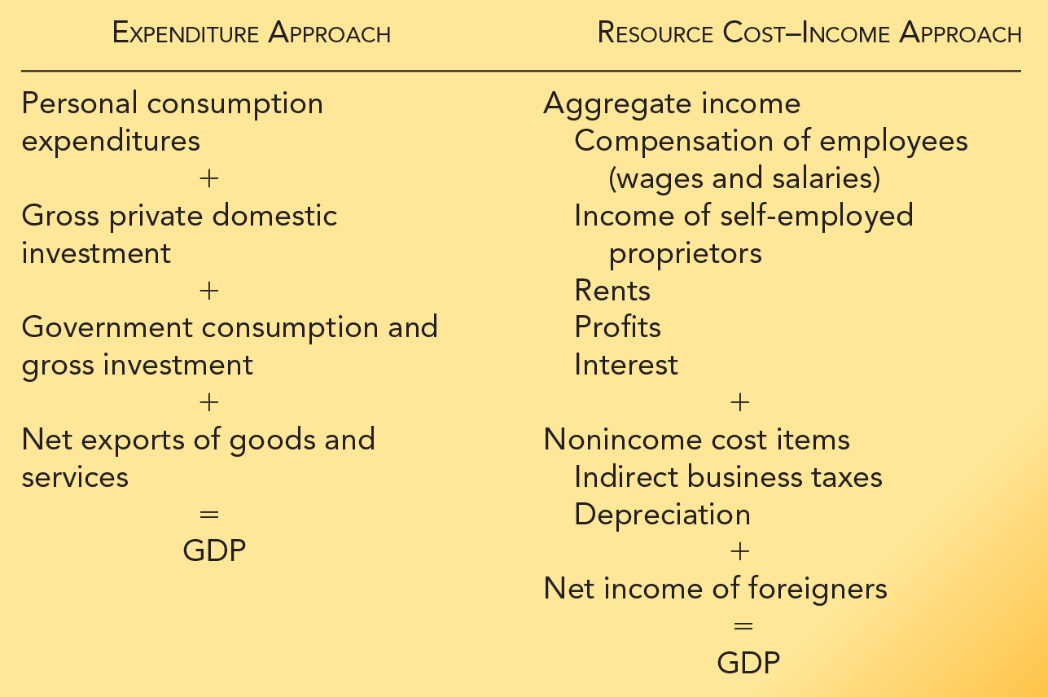
Two Ways of Measuring GDP: A Summary

Slide 17
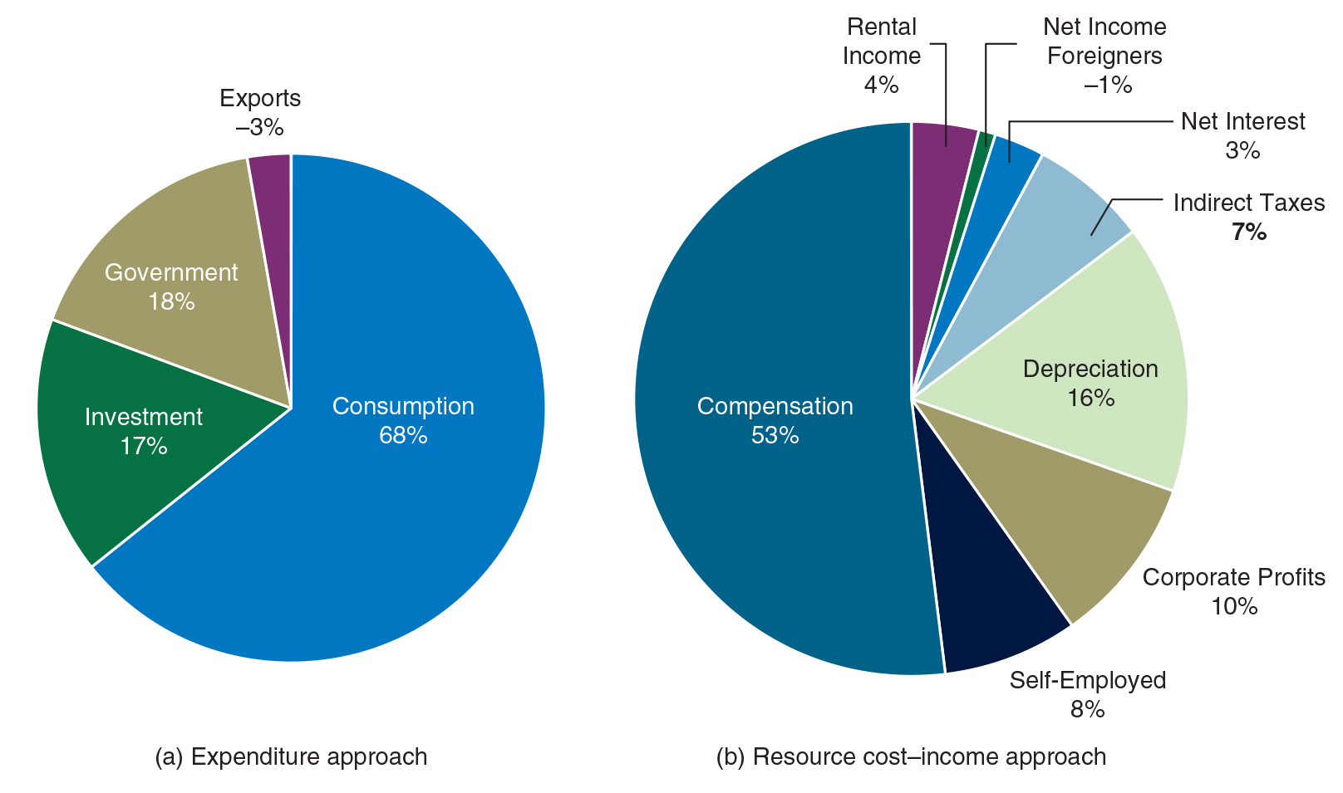
U.S. GDP Components: 2016-2019
The relative sizes of the major components of U.S. GDP usually fluctuate within a fairly narrow range.
The average proportion of each U.S. component during the 2016-2019 period is shown to the right for both the expenditure and resource cost-income approach.

Slide 18
Questions for Thought:
1. Which of the following is GDP designed to measure?
(a) Total market value of goods & services produced in a year.
(b) The income generated and costs incurred producing goods and services during a year.
(c) Both (a) and (b)
2. What is the largest component of GDP when it is derived by the expenditure approach? What is the largest component of GDP when it is derived by the income-cost approach?

Slide 19
Adjusting for Price Changes and Deriving Real GDP

Slide 20
Real and Nominal GDP
The term “real” means adjusted for inflation.
Price indexes are use to adjust income and output data for the effects of inflation.
A price index measures the cost of purchasing a market basket (or “bundle”) of goods at a point in time relative to the cost of purchasing the same market basket during an earlier reference (or base) period.
Notes:
When comparing GDP across time periods, however, we confront a problem; the nominal value of GDP may increase as the result of either (1) an expansion in the quantity of goods produced or (2) higher prices. When comparing data at different points in time, it is nearly always the real changes that are of most interest.

Slide 21
Key Price Indexes:
Consumer Price Index (CPI):
Measures the impact of price changes on the cost of a typical bundle of goods and services households purchase.
Chained Consumer Price Index (Chained CPI):
A version of the CPI that adjusts the quantities of the typical market basket each month to reflect the impact of shifts away from goods that have become relatively more expensive.
GDP Deflator:
designed to measure the change in the average price of the market basket of goods included in GDP.

Slide 22
Differences Among the Key Price Indexes:
The GDP deflator is a broader price index than the CPI. It reflects the bundle included in GDP while the CPI reflects only the bundle purchased by households.
Because of their more frequent updating of the typical market bundle and adjustment for the substitution away from goods with higher relative prices, the chained CPI and GDP deflator generally provide a slightly lower estimate for the annual rate of inflation than the traditional CPI.

Slide 23
What is Inflation?
Inflation is an increase in the general level of prices.
It is typically calculated annually.
The Rate of Inflation is calculated as:
Inflation can be calculated using either the CPI or the GDP deflator.
$$\begin{matrix}Inflation \\ rate\end{matrix} = \frac{\begin{matrix}This year^{′}s \\ price index\end{matrix} − \begin{matrix}Last year^{′}s \\ price index\end{matrix}}{\begin{matrix}Last year^{′}s \\ price index\end{matrix}} × 100$$
■8(𝐼𝑛𝑓𝑙𝑎𝑡𝑖𝑜𝑛@𝑟𝑎𝑡𝑒) = (■8(𝑇ℎ𝑖𝑠 𝑦𝑒𝑎𝑟^′ 𝑠@𝑝𝑟𝑖𝑐𝑒 𝑖𝑛𝑑𝑒𝑥) − ■8(𝐿𝑎𝑠𝑡 𝑦𝑒𝑎𝑟^′ 𝑠@𝑝𝑟𝑖𝑐𝑒 𝑖𝑛𝑑𝑒𝑥))/■8(𝐿𝑎𝑠𝑡 𝑦𝑒𝑎𝑟^′ 𝑠@𝑝𝑟𝑖𝑐𝑒 𝑖𝑛𝑑𝑒𝑥) × 100
This year’s
price index
-
Last year’s
price index
x
100
Last year’s
price index
Notes:
Inflation: An increase in the general level of prices of goods and services. The purchasing power of the monetary unit, such as the dollar, declines when inflation is present.

Slide 24
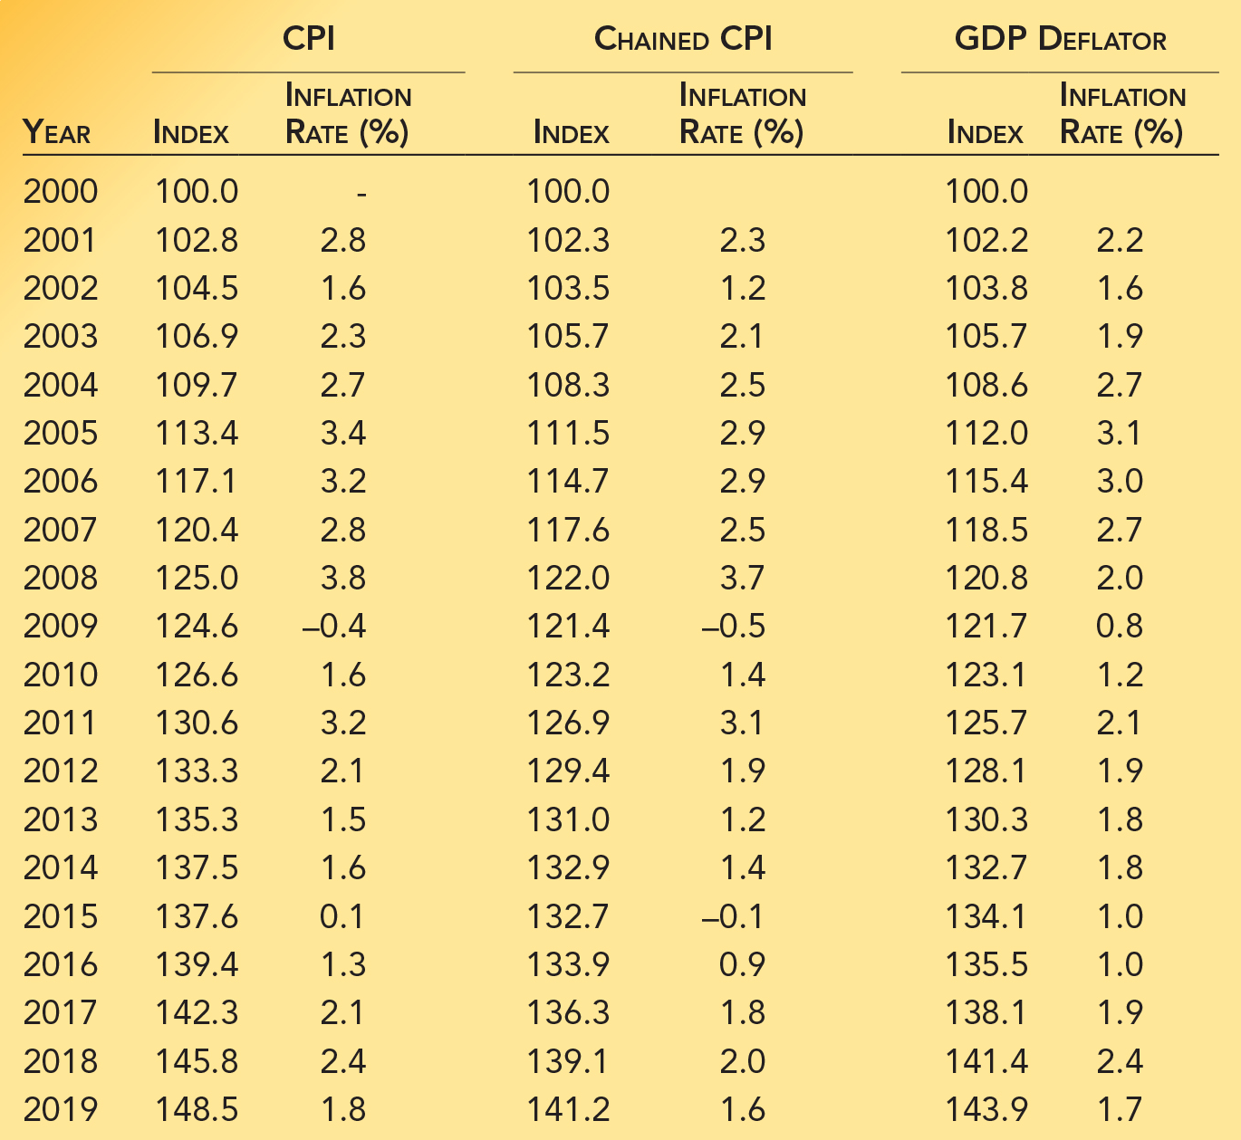
CPI, Chained CPI, and the GDP Deflator: 2000-2019
Even though the CPI and the GDP deflator are based on different market baskets and procedures, they yield similar estimates of the rate of inflation.
However, because of more frequent updating of the market bundle and adjustment for substitution away from goods with relatively higher prices, the chained CPI and GDP deflator generally indicate that inflation is between 0.2 and 0.3 percent lower than the CPI.

Slide 25
Using the GDP Deflator to Derive Real GDP
The formula for converting nominal GDP into real GDP (in period 1 prices) is:
${Real GDP}_{2}={Nominal GDP}_{2} × \frac{{GDP Deflator}_{1}}{{GDP Deflator}_{2}}$
〖𝑅𝑒𝑎𝑙 𝐺𝐷𝑃〗_2=〖𝑁𝑜𝑚𝑖𝑛𝑎𝑙 𝐺𝐷𝑃〗_2 × 〖𝐺𝐷𝑃 𝐷𝑒𝑓𝑙𝑎𝑡𝑜𝑟〗_1/〖𝐺𝐷𝑃 𝐷𝑒𝑓𝑙𝑎𝑡𝑜𝑟〗_2
Data on both money (nominal) GDP and price changes are essential for meaningful comparisons of output between two time periods.
GDP Deflator₁
Nominal GDP₂
x
GDP Deflator₂
Notes:
We can use the GDP deflator together with nominal GDP to measure real GDP, which is GDP in dollars of constant purchasing power. If prices are rising, we simply deflate the nominal GDP during the latter period to account for the effects of inflation.

Slide 26
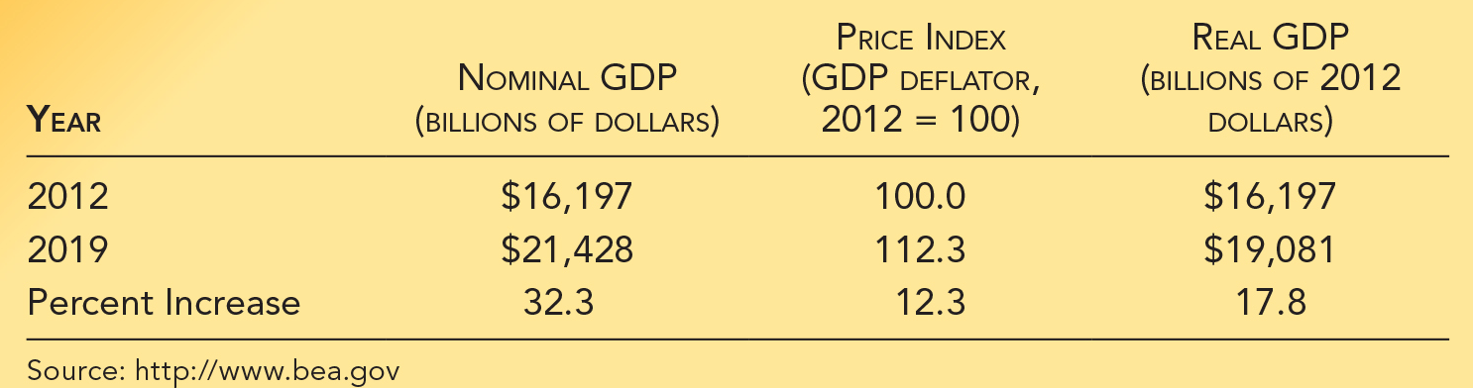
Using the GDP Deflator to Derive Real GDP
Between 2012 and 2019, nominal GDP increased from $16,197 billion to $21,428 billion, an increase of 24.4 percent.
But, when the 2019 GDP is deflated to account for price increases we can see real GDP increased by 13.3 percent.

Slide 27
Converting Earlier Figures into Current Dollars
Sometimes we will want to make real data (e.g. income) comparisons in terms of the purchasing power of the dollar during the current year.
${Figure}_{current \$}={Figure}_{earlier \$} × \frac{{price index}_{current year}}{{price index}_{earlier year}}$
〖𝐹𝑖𝑔𝑢𝑟𝑒〗_(𝑐𝑢𝑟𝑟𝑒𝑛𝑡 $)=〖𝐹𝑖𝑔𝑢𝑟𝑒〗_(𝑒𝑎𝑟𝑙𝑖𝑒𝑟 $) × 〖𝑝𝑟𝑖𝑐𝑒 𝑖𝑛𝑑𝑒𝑥〗_(𝑐𝑢𝑟𝑟𝑒𝑛𝑡 𝑦𝑒𝑎𝑟)/〖𝑝𝑟𝑖𝑐𝑒 𝑖𝑛𝑑𝑒𝑥〗_(𝑒𝑎𝑟𝑙𝑖𝑒𝑟 𝑦𝑒𝑎𝑟)
If prices have risen, this will “inflate” the data for earlier years and bring them into line with the current purchasing power of the dollar.
This can be done by “inflating” the data for earlier years for increases in the price level.
The formula for converting the figures for an earlier year into current dollars is:
GDP Deflator₁
Nominal GDP₂
x
GDP Deflator₂
Notes:
If we are comparing prices from earlier years we simply inflate the nominal GDP during the earlier period to account for the effects of inflation.

Slide 28
Questions for Thought:
1. What do price indexes measure?
2. What is the difference between the CPI and the GDP deflator? How about between the CPI and Chained CPI? Which would you use if you wanted to measure whether your own earnings this year were higher than they were last year?
3. The CPI was 241.0 in 2016 compared to 99.6 in 1983. Suppose that the price of a ticket at a local movie theater rose from $4 to $12 between 1983 and 2016. Did the real ticket price increase or decrease? Calculate the 1983 ticket price measured in 2016 dollars.

Slide 29
Questions for Thought:
 | Nominal GDP (trillions of $) | GDP deflator (2012=100.0)
2015 | $18.24 | 104.6
2017 | 19.54 | 107.8
2019 | 21.43 | 112.3
4. Use the above data to answer these questions.
(a) Calculate real GDP in 2015, 2017, and 2019 in 2012 dollars.
(b) What was the percent change in real GDP between 2015 and 2017? What was the percent change between 2017 and 2019?

Slide 30
Problems with GDP as a Measuring Rod

Slide 31
Shortcomings of GDP as a Measuring Rod
Shortcomings of GDP:
It does not count non-market production.
It does not count the underground economy.
It makes no adjustment for leisure.
It probably understates output increases because of the problem of estimating improvements in the quality of products.
It does not adjust for harmful side effects.
It understates well being in the information age.
Notes:
Real GDP is an imperfect measure of current output and income. Some productive activities are omitted because their value is difficult to determine. The introduction of new products complicates the use of GDP as a measuring rod. Also, when production involves harmful side effects (negative externalities such as pollution) that are not fully registered in the market prices, GDP will fail to measure the level of output accurately.

Slide 32

Entrepreneurs Who have
Changed Our Lives: Steve Jobs
• Some entrepreneurs bring about changes that touch nearly everyone in the world. The late Steve Jobs, co-founder and the marketing genius of Apple Inc., was such an entrepreneur. In 1977 he and his friend Stephen Wozniak created one of the first personal computers ever made—and it was easy enough for almost anyone to use.
• That was just the beginning. Apple invented the computer’s icon and mouse and the iPhone—tools unknown a generation ago that we now take for granted. Apple also created the iPod, then iTunes, and then the iTunes store, which made it one of the nation’s biggest retailers of music. Then Apple TV appeared, available on an iPhone.
• Jobs tried other businesses. A spectacular success was turning a small company, Pixar, into the company that created Toy Story, the first feature film entirely animated by computer. That company made Jobs a billionaire.
Sean Gallup/Getty Images
Notes:
Jobs, born in 1955, was the adopted son of Paul and Clara Jobs. His father was a machinist. Growing up in Cupertino, California, Jobs became interested in computers after seeing one at the age of 12. But he had other interests, too, including an appreciation of design—he even sat in on a calligraphy course after he dropped out of Reed College in Portland. He never finished college; instead he worked for a fledgling video game company and spent a year in India studying Buddhism. When he returned to the U.S., he and Wozniak started Apple in the Jobs’s garage.
Jobs’s career was like a roller coaster. After the Apple computer came the MacIntosh—brilliantly innovative with icons and a mouse (before that, personal computers operated only with keyboards). But the Mac didn’t sell well. IBM introduced its own personal computer, and Jobs was pushed out of Apple in 1985.
Jobs returned to Apple as CEO in 1997 as it was facing difficult times. He was a key figure in the creation of the iPhone, the revolutionary product—cellphone, camera, music player, and web browser—that turned Apple into one of the world’s largest companies (often the largest in terms of market value). Further, the iPhone and the competitors who followed made communication—with friends, family, businesses, and news—part of our everyday lives.

Slide 33
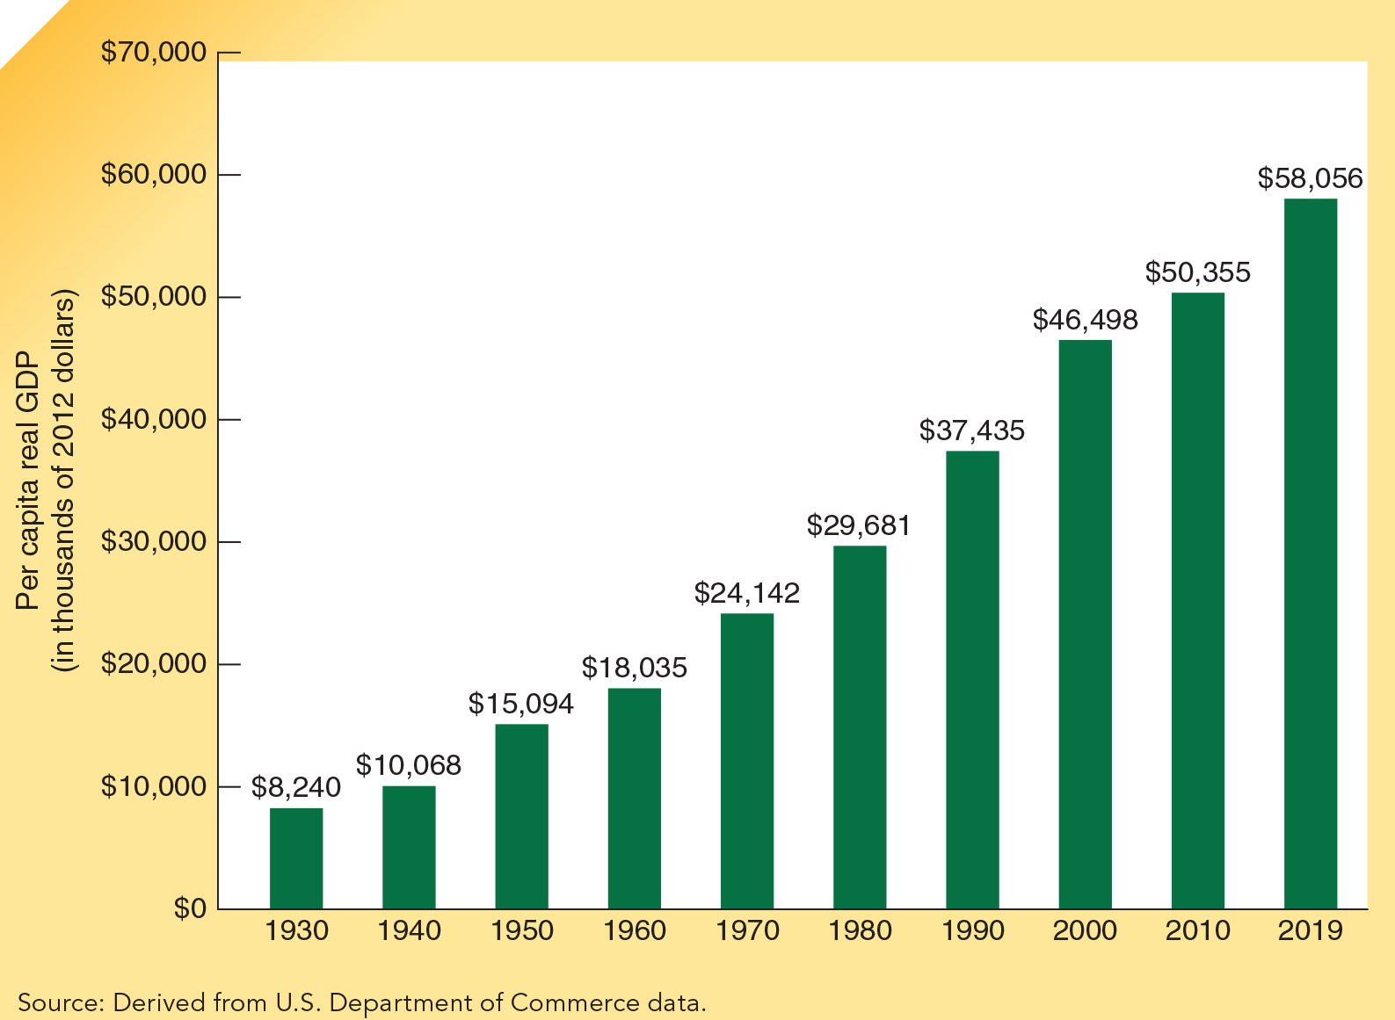
Per Capita GDP 1930-2019
Per capita GDP is GDP divided by the size of the population.
The real 2019 GDP per capita figure in the U.S. is more than seven times the figure for 1930.
How meaningful is this comparison?

Slide 34
Per Capita GDP Comparisons Across Time Periods
As was shown in the previous exhibit, real U.S. per capita GDP has increased substantially over the past 82 years.
Compared to earlier periods, current GDP is probably biased upward because more output now takes place in the market sector and less in the household sector.
However, it is also probably biased downward because of failure to adjust for increased leisure, improvements in the work environment, and the introduction of improved products and new technologies.
The direction of the overall bias is uncertain.

Slide 35
GDP as a Measuring Rod
In spite of its shortcomings, the evidence indicates that real GDP per person is a broad indicator of living standards.
As real per capita GDP in the United States has increased through time, the quality of most goods has increased while the amount of work time required for their purchase has declined.
Similarly, as real per capita GDP has risen in the United States and other countries, life expectancy and leisure time have gone up, while illiteracy and infant mortality rates have gone down.
Notes:
As per capita GDP in the United States has increased over time, the quality of most goods has increased while the amount of work time required for their purchase has declined. In many cases, the changes have been dramatic. Various quality-of-life variables paint a similar picture. For example, as per capita GDP has risen in the United States and other countries, life expectancy and leisure time have gone up, whereas illiteracy and infant mortality rates have gone down. This suggests that increases in per capita GDP and improvements in living standards are closely related.

Slide 36
The Great Contribution of GDP
However, the “great contribution” of GDP is its ability to measure short-term fluctuations in output.
Year-to-year (and quarter-to-quarter) changes in real GDP provide a reasonably precise measure of what is happening to the rate of output.

Slide 37
Questions for Thought:
1. When making income and GDP comparisons across time, why is it important to adjust for changes in the level of prices?
2. If nominal GDP during a year increased by 2% while the GDP deflator rose by 5 %, what happened to real GDP?
3. If the GDP deflator is currently 111.7 compared to the 2012 base year of 100, what does the 111.7 figure for today mean?
4. GDP does not count services such as child care, food preparation, cleaning, and laundry within the household. Why not? Is GDP a sexist measure? Does it understate the productive contributions of women relative to men?

Slide 38
Questions for Thought:
5. On 9/11/2001, terrorists crashed 2 planes into the World Trade Center in New York, killing 3,000 people and causing the towers to collapse. Which of the following best indicates how GDP was impacted by the attack’s damages and cleanup that followed?
(a) The damage from the attack was subtracted from GDP, while the expenditures from the cleanup were added.
(b) Neither the damages from the attack nor the expenditures from the cleanup affected GDP.
(c) No adjustment was made for the damages from the attack, while the expenditures from the cleanup were added to GDP.

Slide 39
Questions for Thought:
6. Which of the following are included in GDP?
(a) the value of goods produced in the underground economy
(b) the value of leisure
(c) increases in the value of housing and financial assets
(d) depreciation in the value of real assets such as equipment and buildings
(e) the value of services such as food preparation and house cleaning that we provide for ourselves

Slide 40
Questions for Thought:
7. Your father tells you he earned $1.50 per hour when he was 16 in 1969; you made $8.00 per hour when you were 16 in 2015. Given that the CPI was 36.7 in 1969 and 237.0 in 2015, which of the following is the 2015 equivalent of your father’s hourly earnings when he was 16?
(a) $0.23
(b) $3.55
(c) $9.69
(d) $18.96
(e) $50.05

Slide 41
End of Chapter 7

